Slide 1
Predicting the Best College Basketball Players
Cory DeMar
&
Blake Francis

Slide 2
What Are We Trying to Address and Why?
What is an effective way to recruit the best college players into the NBA?
Based on Player Position and a minimum of 16 minute average playing time per game
Based on “NBA Player Efficiency Rating”
Why?
We would like to help scouts make better informed decisions so that they can minimize their “error” from drafting poor NBA candidates

Slide 3
Reading in the Data
Libraries:
Statsmodel.formula.api, Pandas
NBA vs. College stats from Excel
Empty lists for each position
List of lists
Conditional append to each empty list based on position and minutes played
http://www.espn.com/mens-college-basketball/statistics
https://www.basketball-reference.com/leagues/NBA_2017_per_game.html

Slide 4
Algorithms
Strings to floats
Created 3 separate data frames
removed data frame columns
Created a prediction model for each position
Dependent variable = PER
Independent variables = Most important predicators (stats) for that position
Notes:
Based on which stats were least efficient stats for that position (guard, forward, center)

Slide 5
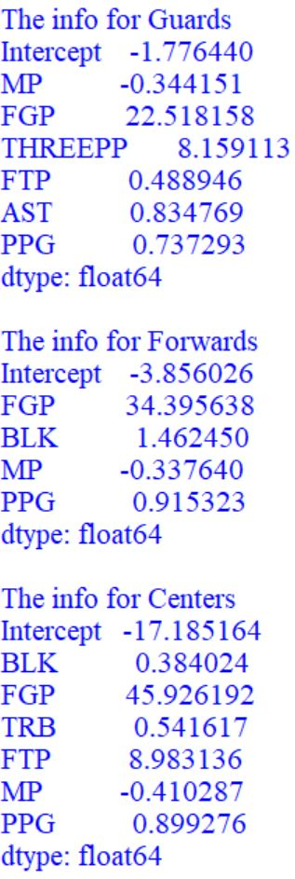
Algorithms Continued…
Tested models against college data set
Paired player names with the “PER”
List of vectors
Sorted “PER” in descending order

Slide 6
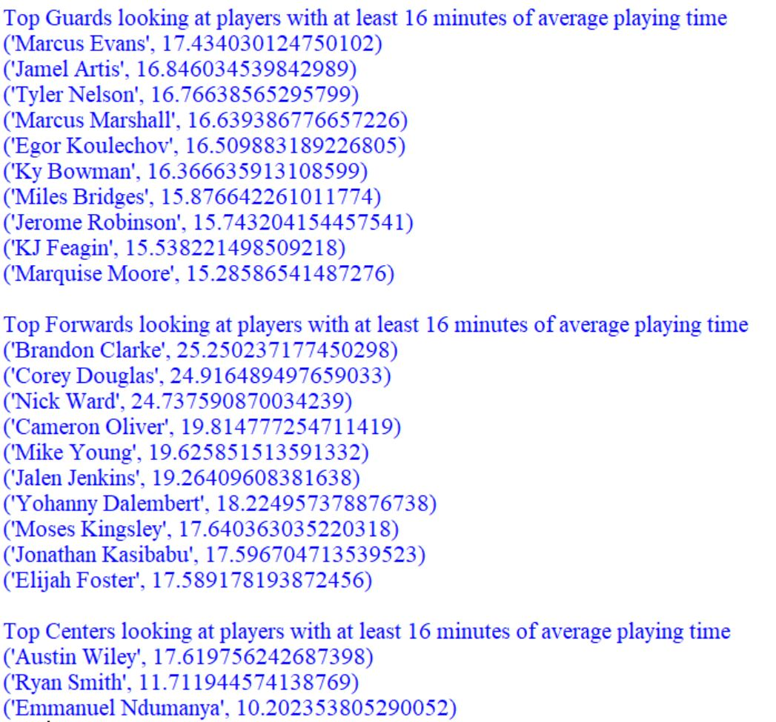
Results

Slide 7
Summary
Created prediction model based on NBA stats
Tested model against college players from 22 colleges
Got a prediction of the PER for the college players
Found the potential best players based on PER in our sample

Slide 8
Conclusion

